Slide 1

AirPulse
Luta Alexandra Denisa
Aghiorghioaie Fabian
Delcea Andrei Iacob
Guta Dan Alexandru

Slide 2



ABOUT
INTEGRATED ECOSYSTEM
MEASUREMENTS
LOCAL DATA
ALERTS
FORECAST

Slide 3
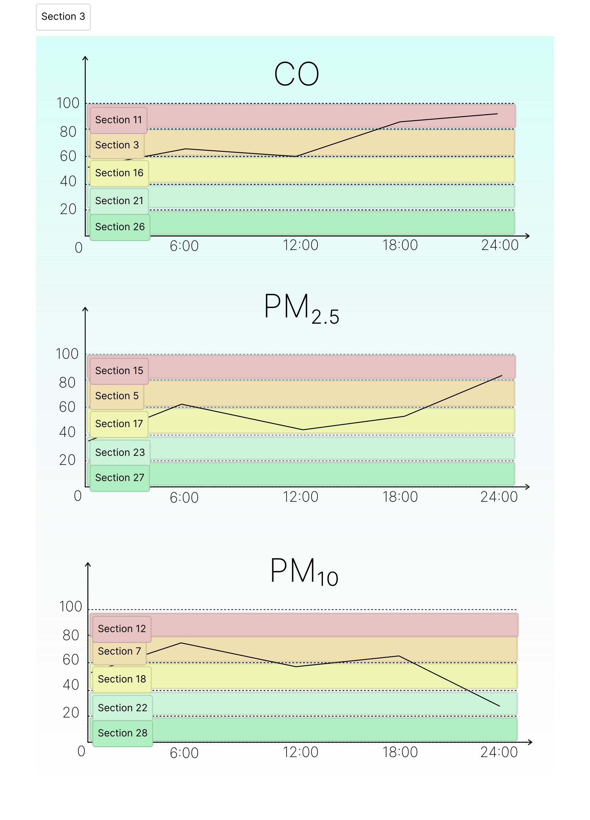
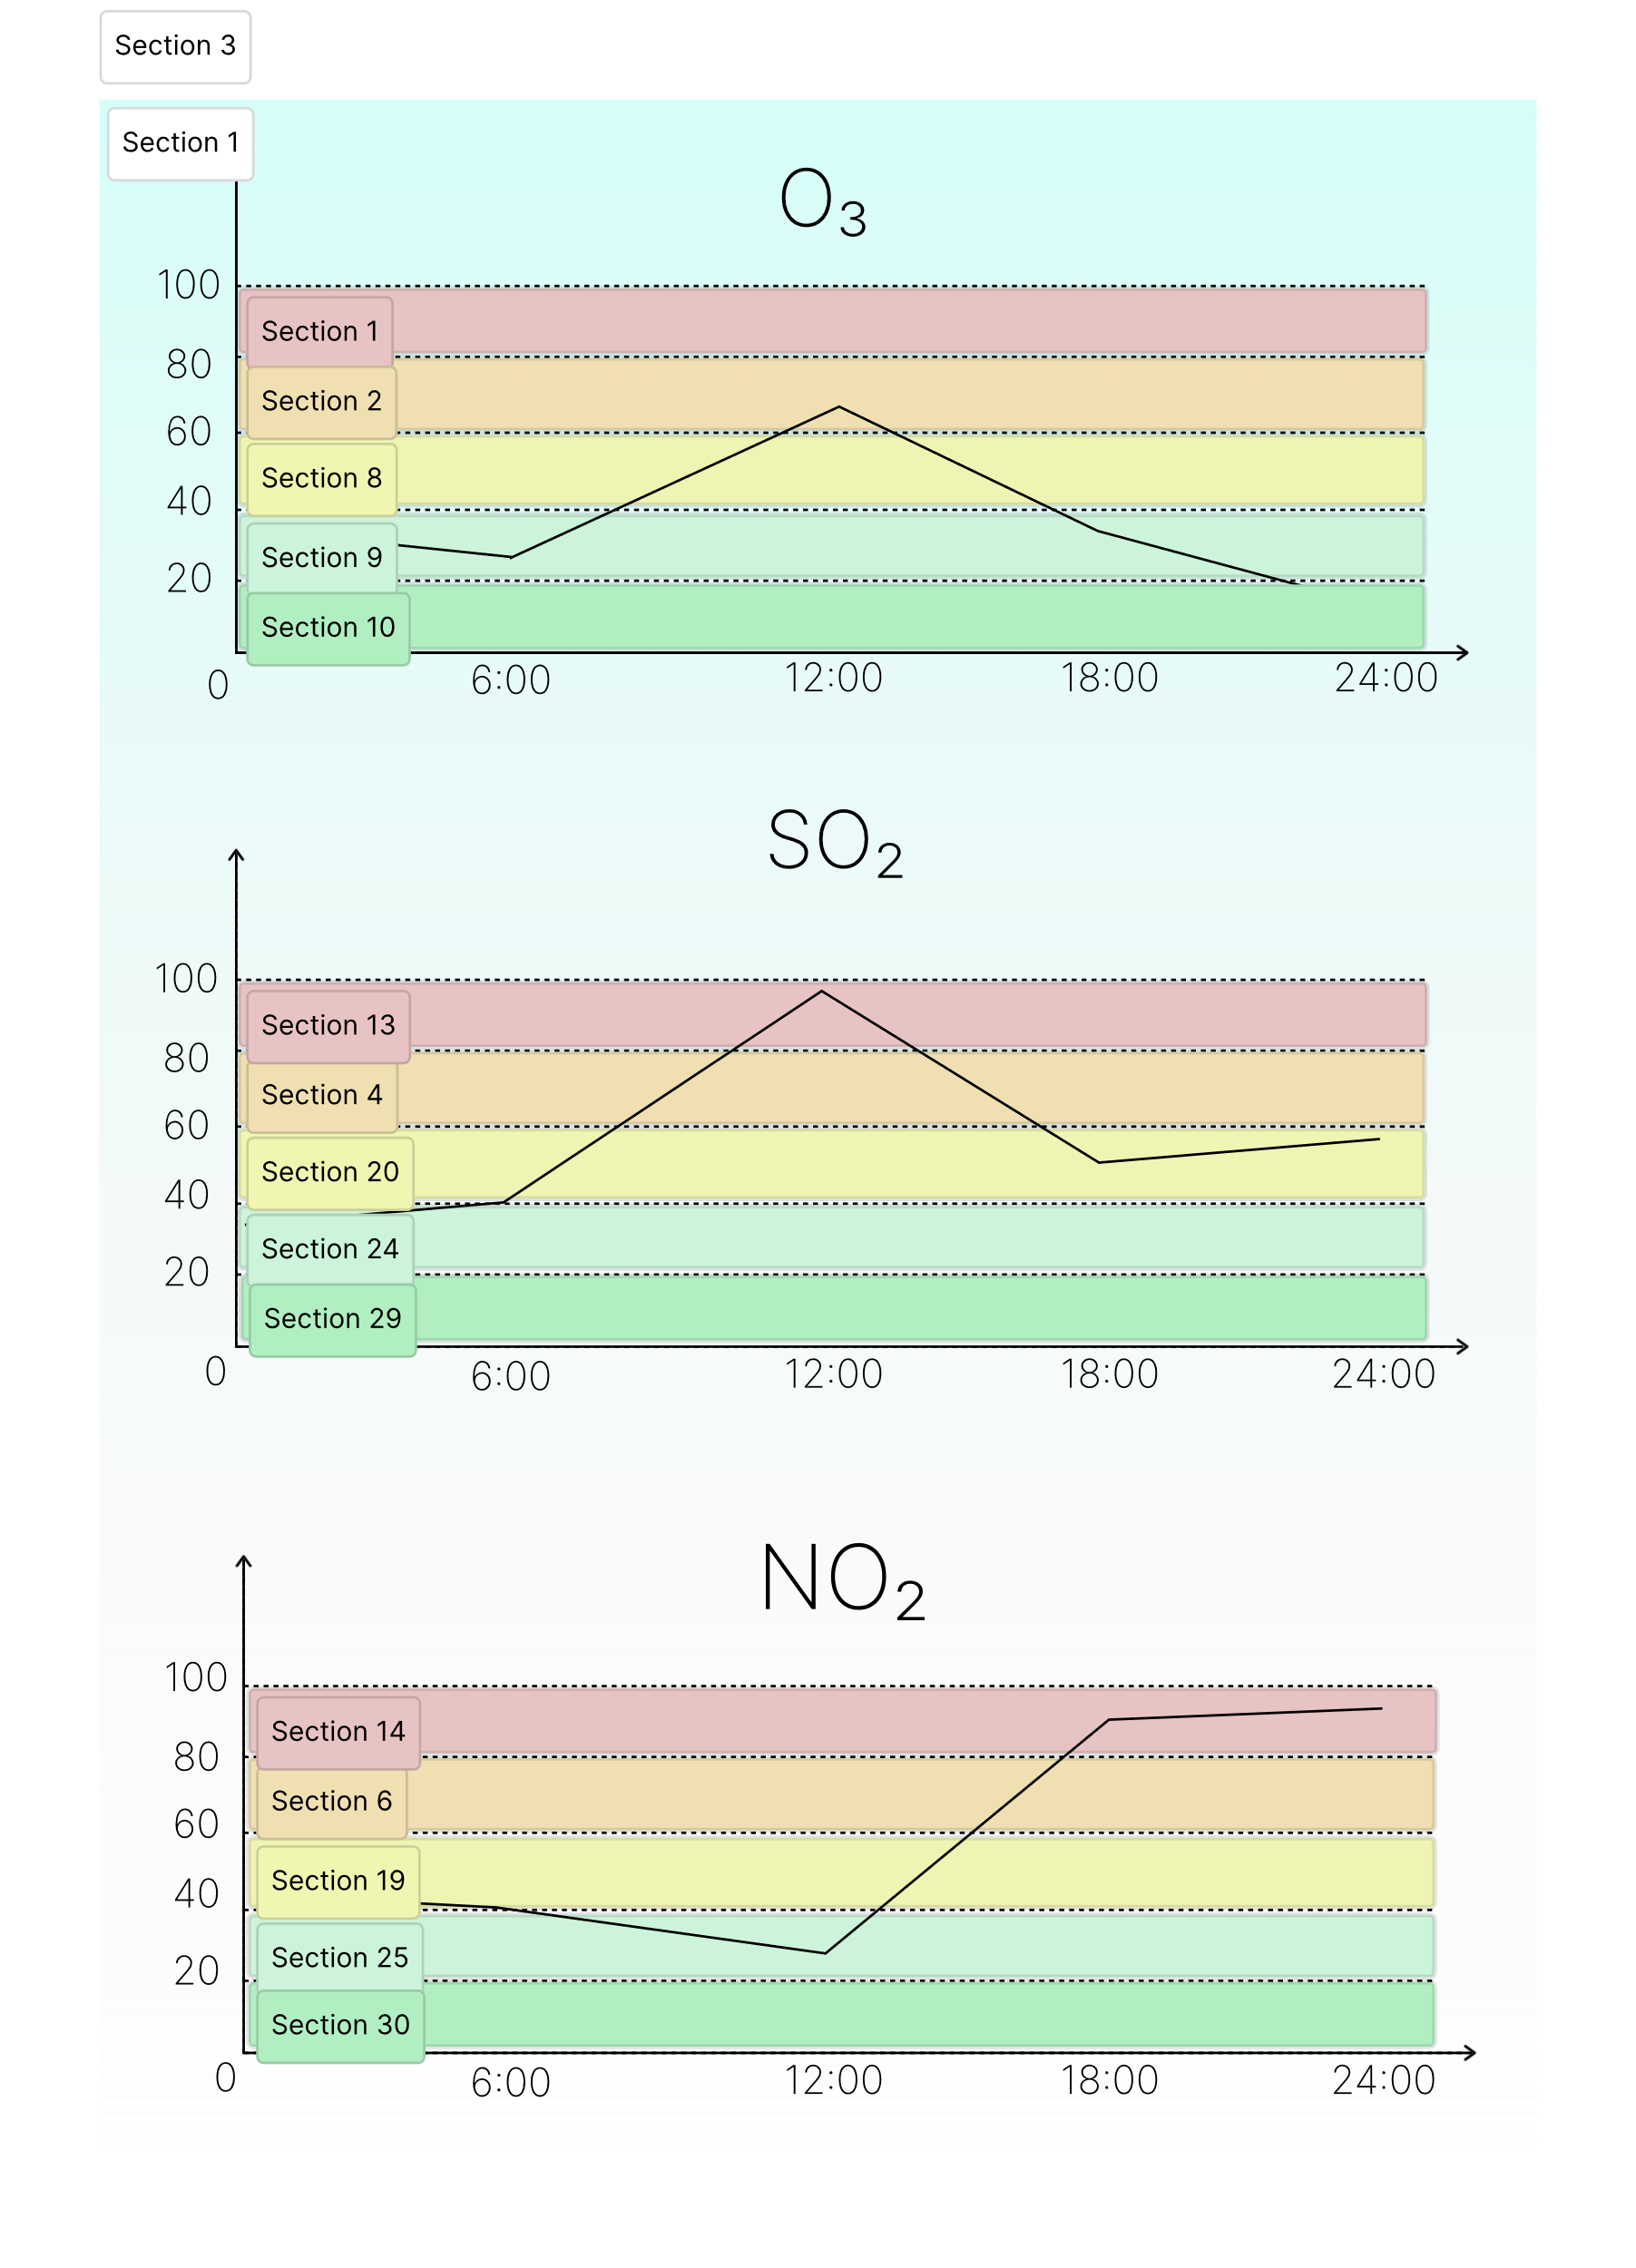
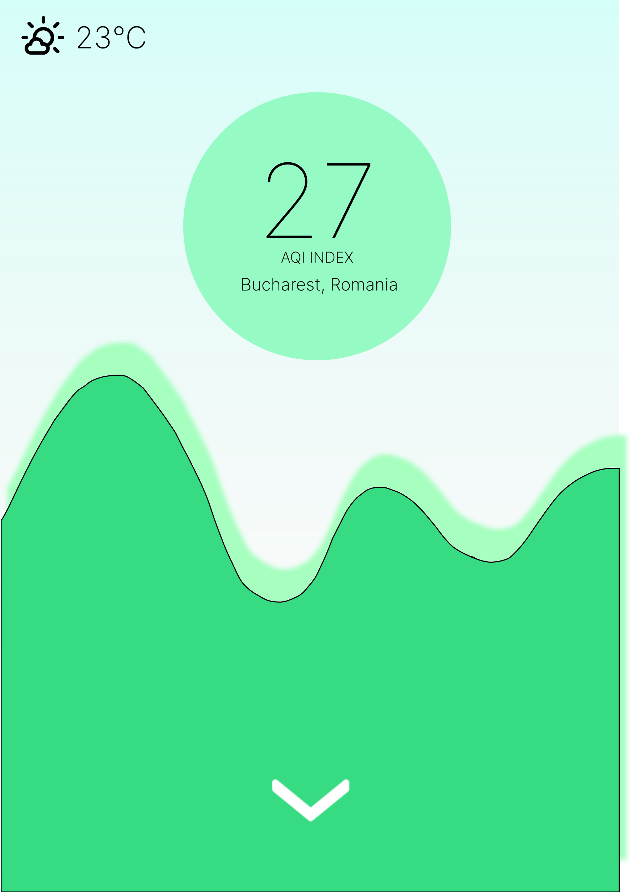
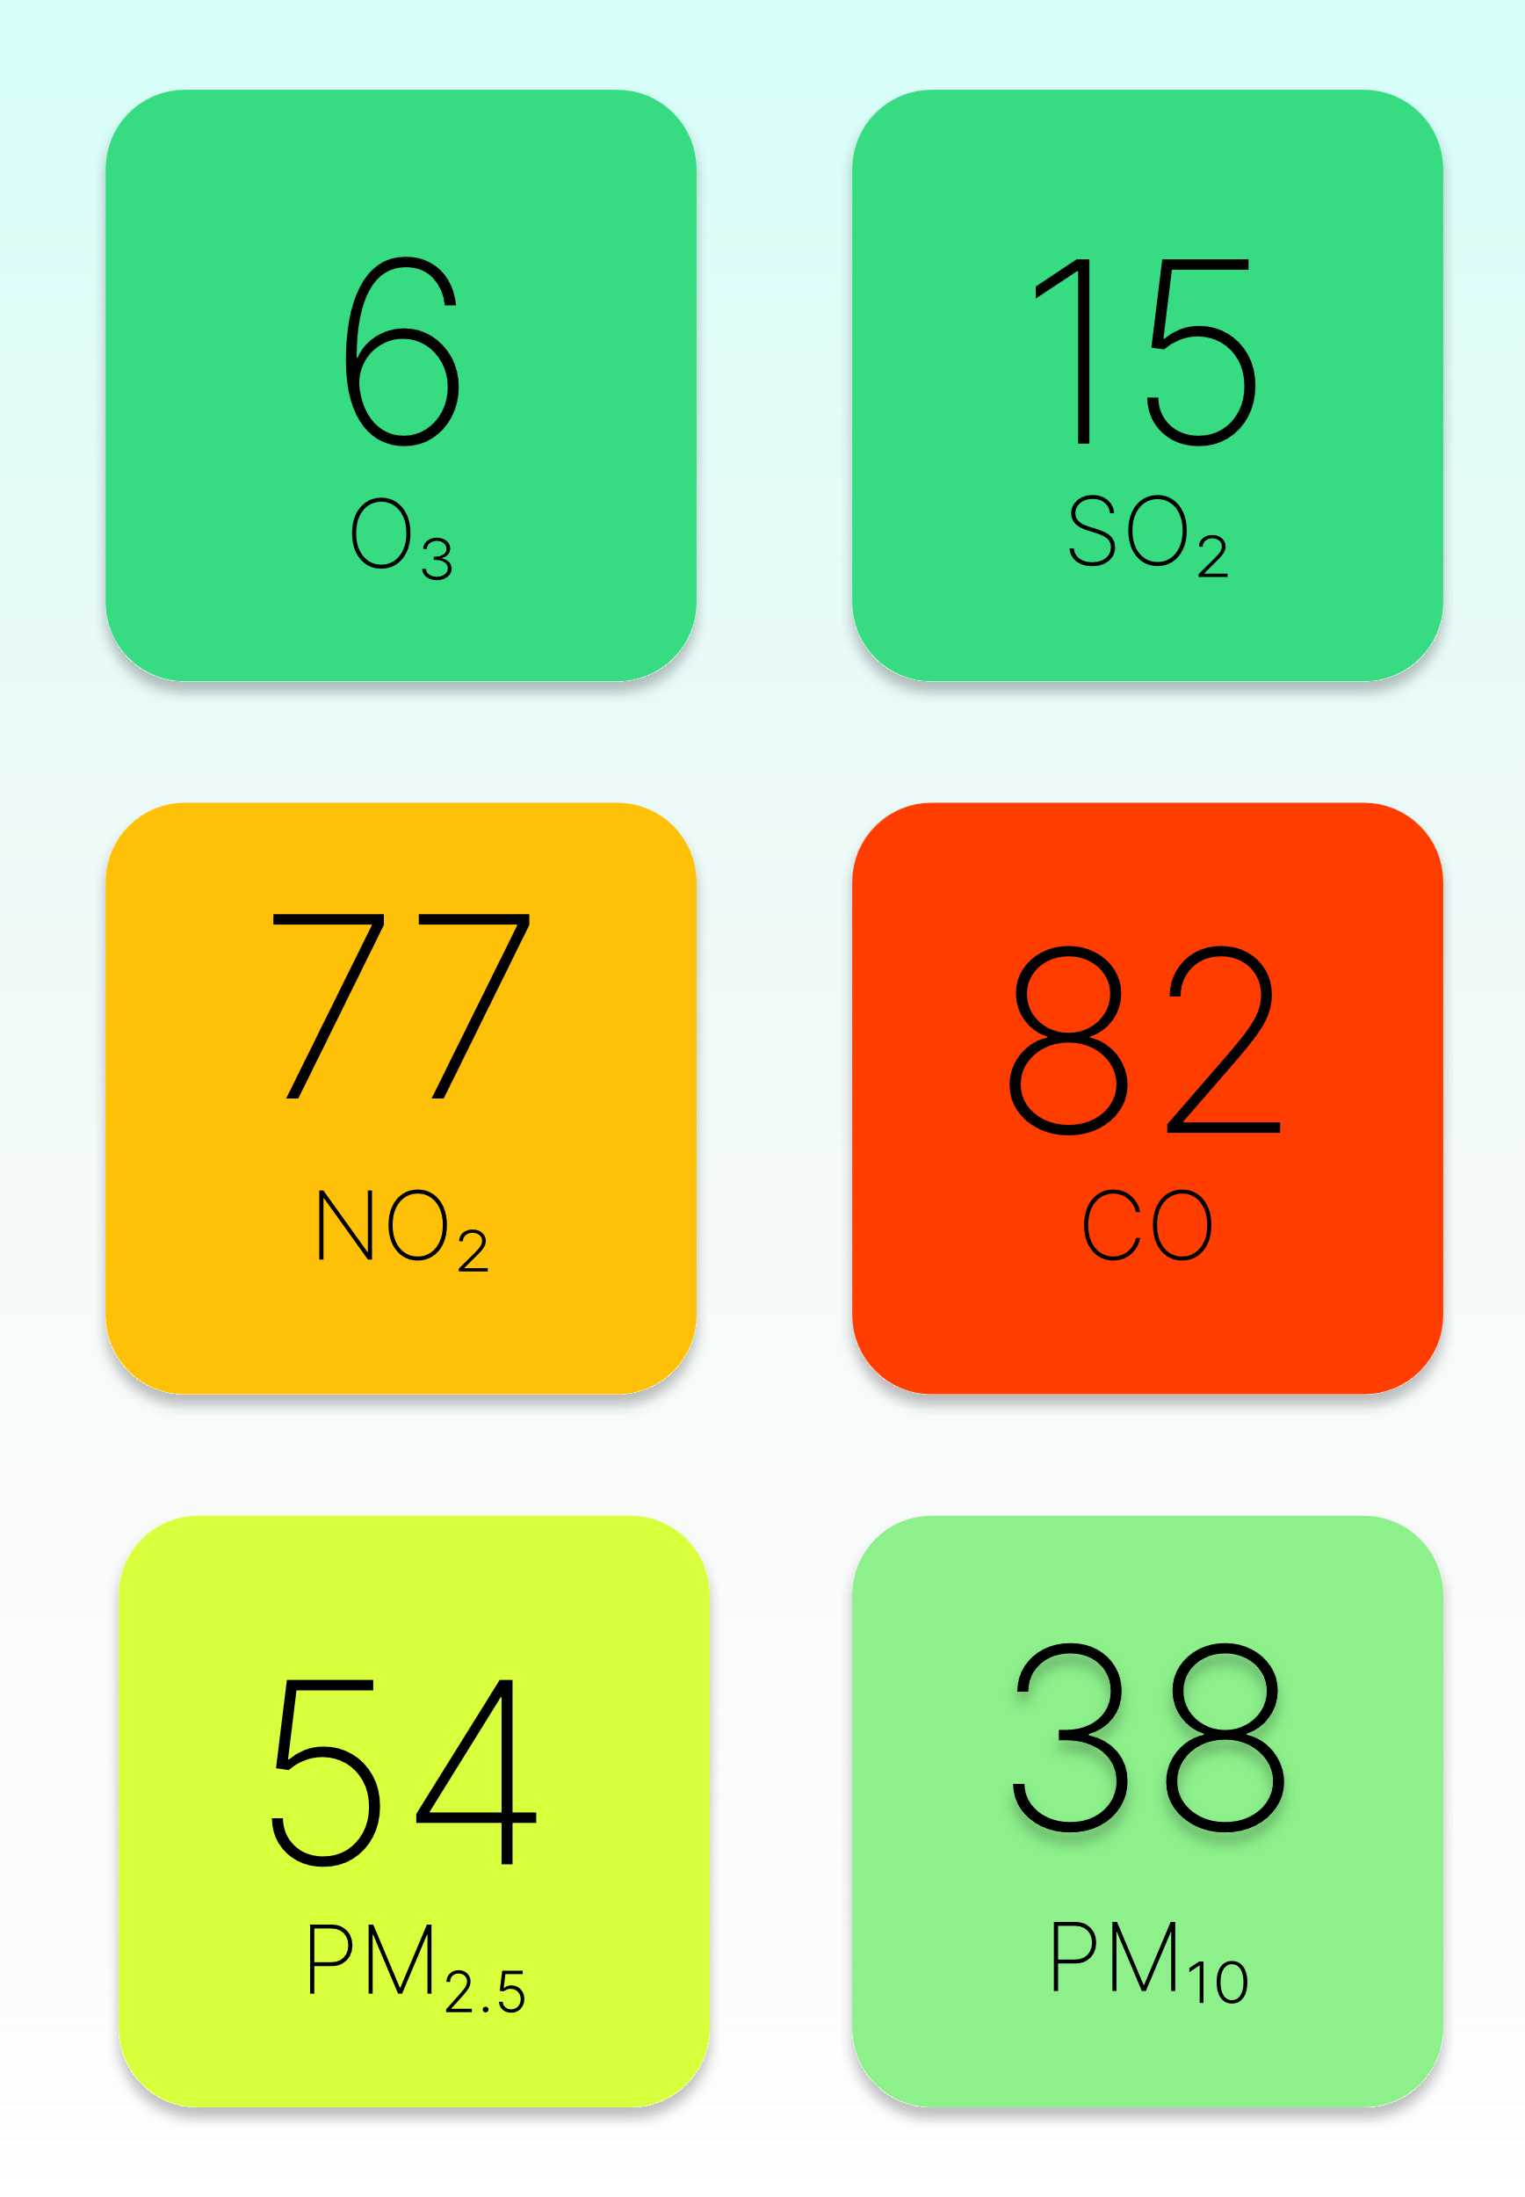
MOBILE
PAST PRESENT FUTURE

Slide 4
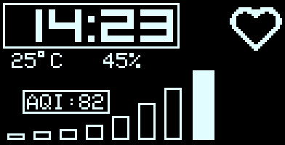
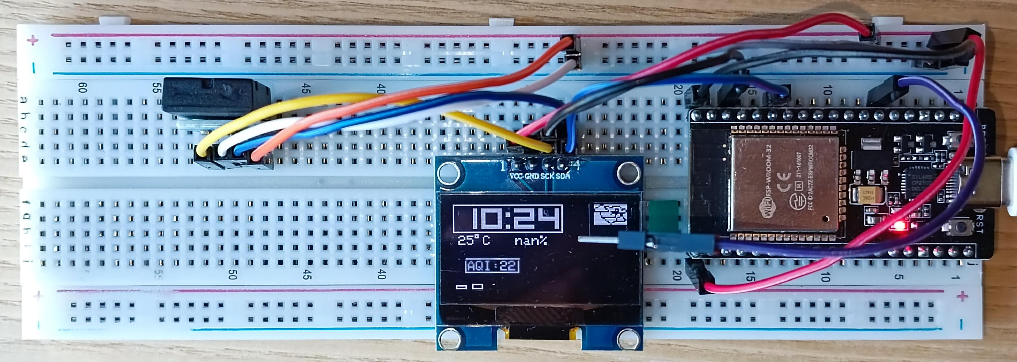
WEARABLE
AT A GLANCE

Slide 5
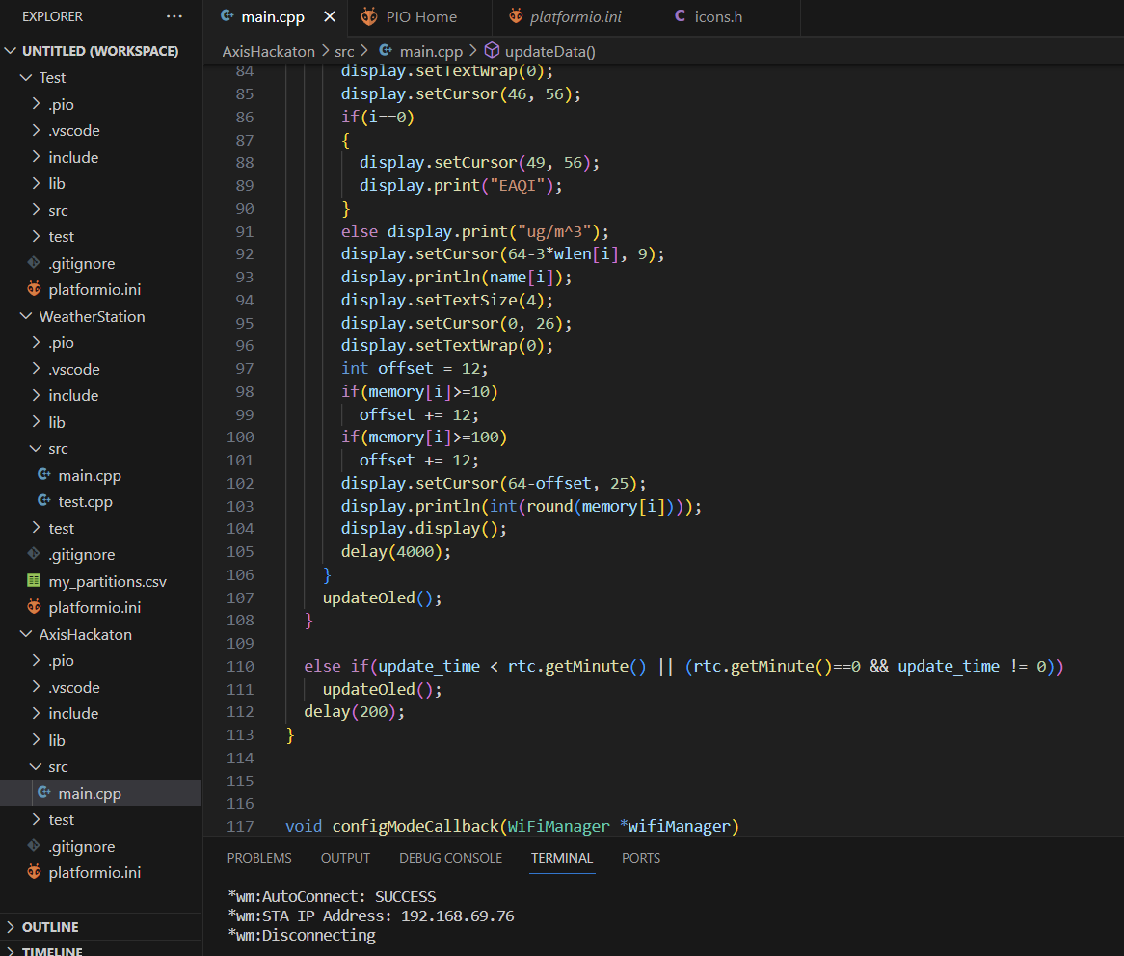
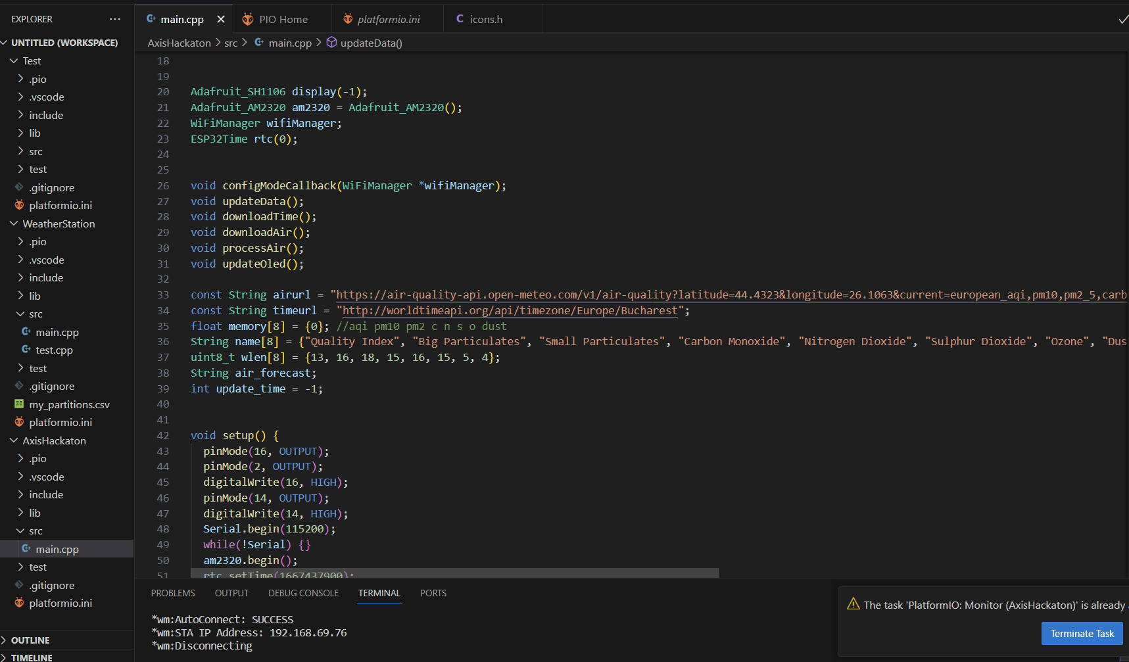

Slide 6
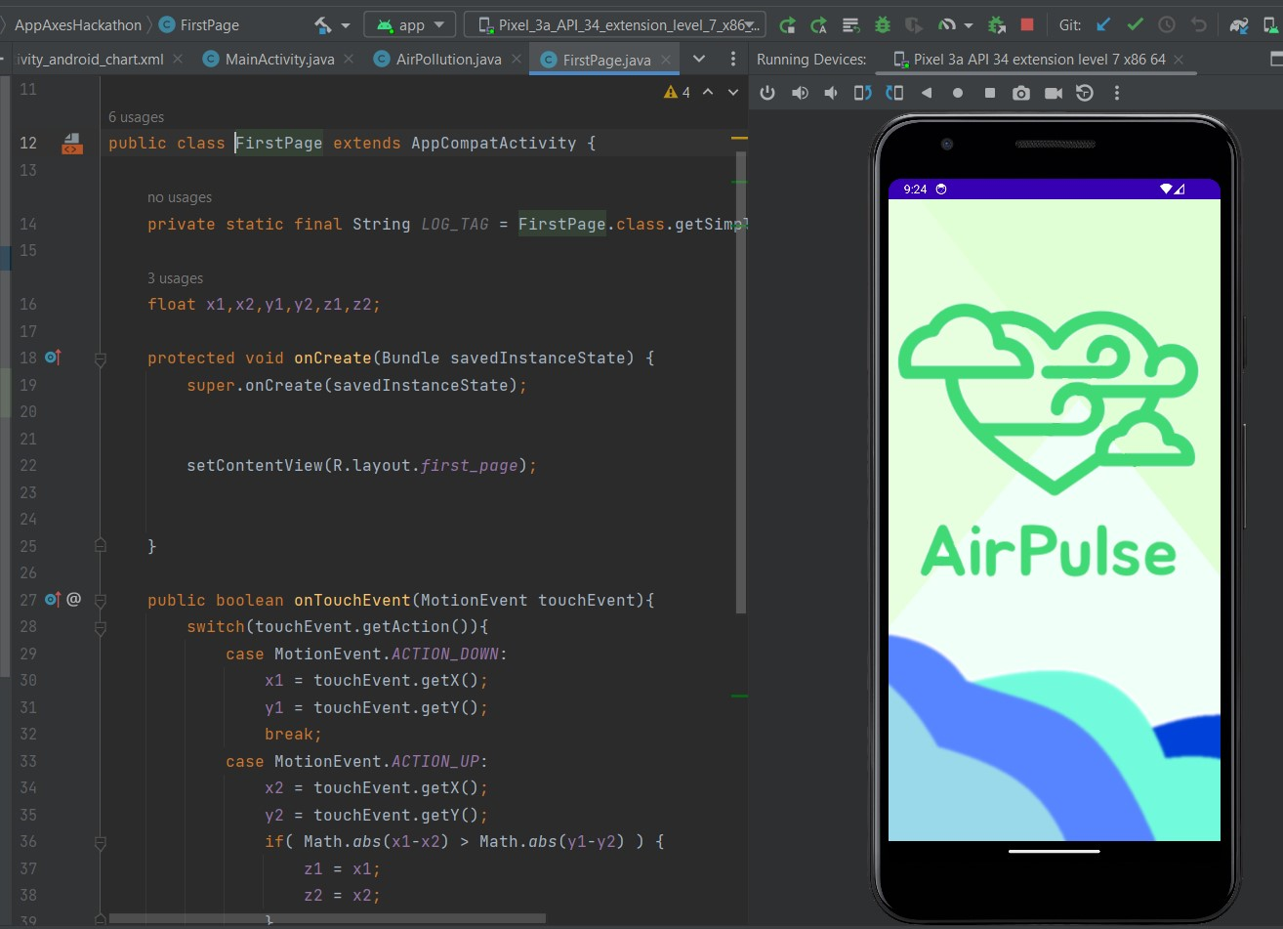
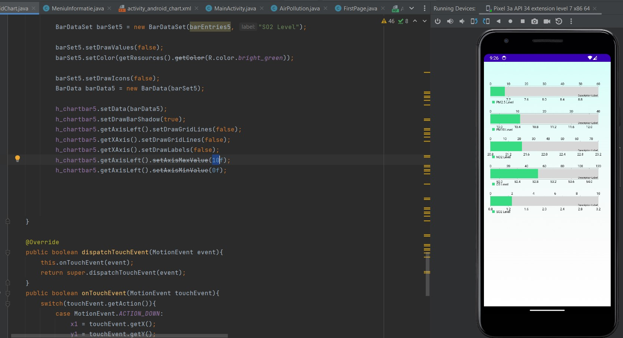

Slide 7
“Your most unhappy customers are your greatest source of learning.”
-Bill Gates, Microsoft CEO

Slide 8
THANK YOU FOR YOUR ATTENTION!

